Slide 1
Healthy Recipes

Slide 2
Chicken Wrap (1)
What you need (ingredients):
4 whole-wheat wraps (8 inches)2 cups store-bought rotisserie chicken (chicken that is already cooked) ½ cup shredded carrots1 avocado, thinly sliced1 cup baby spinach leaves¼ cup of your favorite fat-free/low-fat dressing (about 1 tablespoon per wrap-ex: italian or ranch dressing)
What to do (directions):
Place wraps side by side on a flat surface. Divide chicken into four portions (about ½ cup each). Place a portion of chicken on each wrap.Top each wrap with carrots, avocado, and spinach. (Have an adult help with the chopping.)Drizzle dressing evenly over each wrap.Roll each wrap up tightly and cut on the diagonal.Serve immediately or wrap tightly in aluminum foil and refrigerate for lunch the next day.

Slide 3
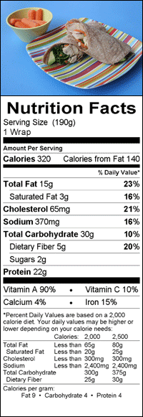
Chicken Wrap (2)

Slide 4
Chocolate Sweetheart Parfait (1)
What you need (ingredients):
½ teaspoon cocoa powder1 teaspoon vanilla extract2 teaspoons honey1½ cups low-fat or fat free Greek yogurt2 cups fresh or frozen raspberries¼ cup shaved dark chocolate or chocolate chips
What to do (directions):
In medium bowl, whisk together cocoa powder and vanilla. Add honey and yogurt and stir until they're well combined with cocoa mixture. It will turn light brown. Spoon 2 tablespoons of yogurt mixture into the bottom of four clear glasses. Top with some raspberries and repeat until all of the yogurt and raspberries are used up. Sprinkle each parfait with chocolate shavings. Serve or refrigerate until ready to serve.

Slide 5
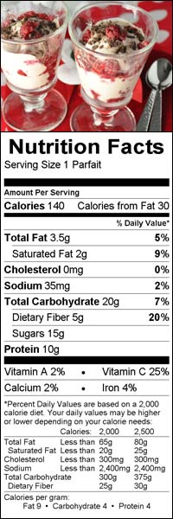
Chocolate Sweetheart Parfait (2)

Slide 6
Cream Cheesy Cucumber Sandwiches (1)
What you need (ingredients):
¾ cup light cream cheese, slightly softened half a large cucumber, thinly sliced8 slices of whole-wheat bread
What to do (directions):
Spread each slice of bread with cream cheese (about 3 tablespoons per sandwich). Place about 4 cucumber slices on 4 of the slices of bread and top with remaining bread slices. Cut into quarters and serve immediately or wrap sandwiches and save for later.

Slide 7
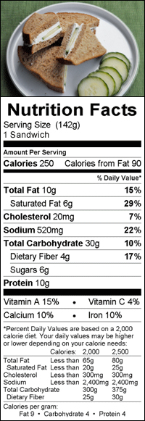
Cream Cheesy Cucumber Sandwiches (2)

Slide 8
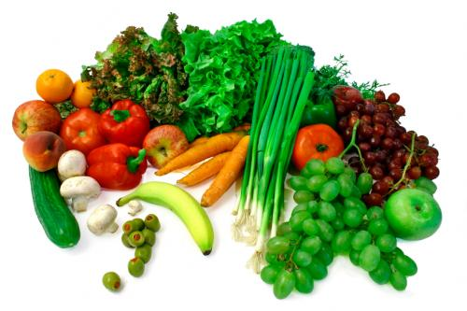
What are the “Things I Need” called?
Start by preheating the oven to 350 degrees. Mix all of the food together. Bake for 25 minutes.
Ingredients
Directions
Ingredients
Directions
*Hint* click on the word

Slide 9
What are the “List of Things to do” called?
Start by preheating the oven to 350 degrees. Mix all of the food together. Bake for 25 minutes.
Ingredients
Ingredients
Directions
Directions
*Hint* click on the word

Slide 10

You were right!

Slide 11

Please try again.

Slide 12

Have a great day!

Slide 13
Works Cited
All recipes, nutritional facts, and pictures came from:
http://kidshealth.org/kid/recipes/#cat20229
(Visit the website above for my recipes and tips on good nutrtion! ☺ )
http://crackberry.com/food-and-nutrition-tracking-applications-blackberry-smartphones-and-playbook-0
http://evaa1990.wordpress.com/2011/07/07/qualities-of-a-good-student/
http://dessertdarling.com/2012/02/thinny-thursday-what-does-gluten-free-mean/sadface-4/
http://departments.bloomu.edu/solve/kidsfun.html

